Slide 1
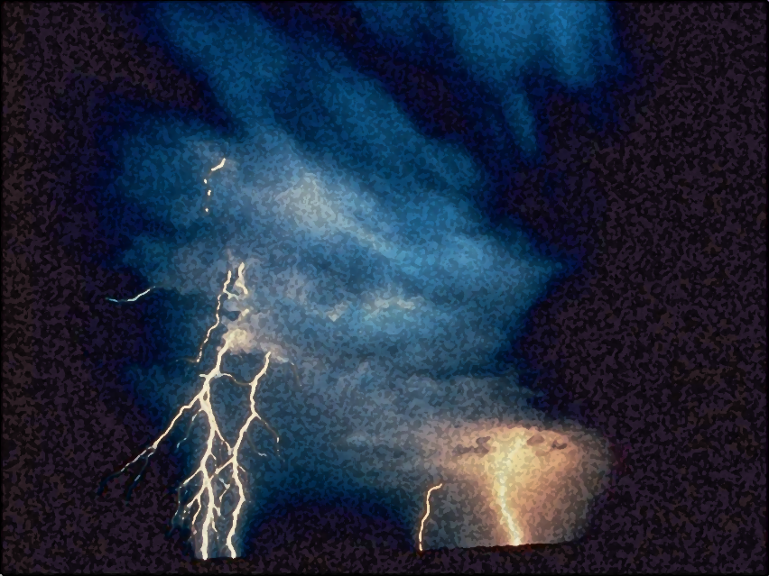

A Light out of Darkness
The Vision of Isaiah
Doom to Bloom

Slide 2


The Vision of Isaiah
The Purpose
How to make useful, faithful and righteous servant of God?
A Call to Servanthood

Slide 3
The Vision of Isaiah
Introduction:
The Present and
Future of God’s People
1-5
6:1-7
From “sinner” to “servant”

Slide 4
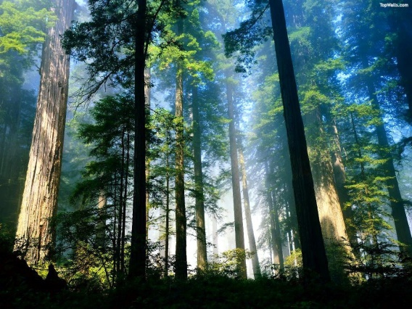
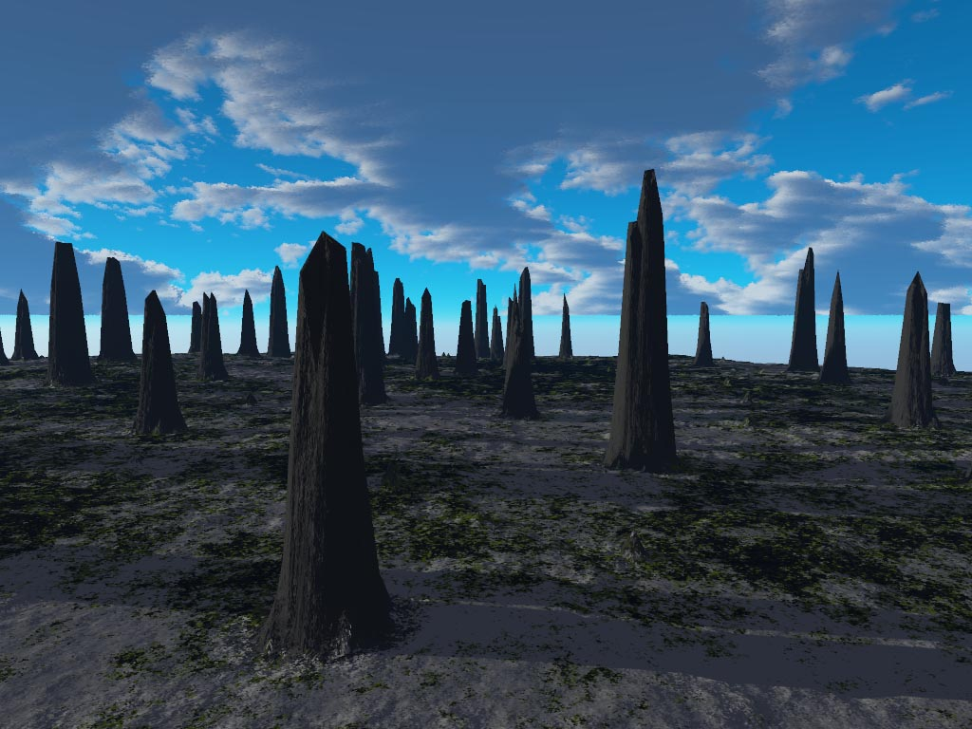
Notes:
"Until the cities are laid waste and without inhabitant, the houses are without a man, the land is utterly desolate, the LORD has removed men far away, and the forsaken places are many in the midst of the land. But yet a tenth will be in it, and will return and be for consuming, as a terebinth tree or as an oak, whose stump remains when it is cut down.” (Isa 6:11-13)

Slide 5
Notes:
“So the holy seed shall be its stump.“ (Isa 6:13) - Bloom out of Doom.

Slide 6
The Vision of Isaiah
In Whom Shall We Trust?
The Basis of Servanthood
7-39
In order to become a Servant of God, one must first learn to trust in the one whom they serve.

Slide 7
The Vision of Isaiah
In Whom Shall We Trust,
the Nations or the LORD?
Example of Distrust
7-12
Ahaz
God: Master of the Nations
13-35
Example of Trust
36-39
Hezekiah
Notes:
Chapter 7-12 gives us an historical example of distrust in the LORD. King Ahaz is given an opportunity to trust in the Lord but refuses to listen, a fulfillment of 6:9-10. The LORD offers him a sign, evidence that the LORD can be trusted. But He refuses to accept the sign. He refuses to trust in the LORD and His word. He instead decides to trust in Assyria and their many gods. Ahaz seeks the help of Tiglath-Pileser king of Assyria, but receives no help, but more trouble. He gets rid of one problem and gets a bigger one in return. The LORD now makes an appearance, prophesied in the sign of Immanuel, “God with us” promised judgment and destruction is upon them when the LORD appears in the form of an invading army. Total destruction is averted at that time, but God will be back.
On the other end we have another historical example, one of trusted in the LORD. King Hezekiah is faced with the same problem, an invading army, the Assyrian have invaded and surrounded him and the nation, with no hope of escape or deliverance. Hezekiah seeks the LORD for help and trusts in the Him and is saved, from destruction and death. The invading army is miraculously destroyed by the LORD Himself. Ahaz trusts Assyria and Israel is destroyed. Hezekiah trusts the LORD and Assyria is destroyed.
Between the two segments is a section whose theme is the God of Israel is the Lord of the nations.

Slide 8
The Vision of Isaiah
Distrust
Ahaz/Jews
Nation of Israel
Judgment
No Annihilation
Trust
Hezekiah/Disciples
Church
Delay in Judgment
“grafted in among them… a partaker of the root and fatness of the olive tree”
“a holy seed shall be its stump”
Notes:
“For if the first fruit is holy, the lump is also holy; and if the root is holy, so are the branches. And if some of the branches were broken off, and you, being a wild olive tree, were grafted in among them, and with them became a partaker of the root and fatness of the olive tree, do not boast against the branches. But if you do boast, remember that you do not support the root, but the root supports you. You will say then, "Branches were broken off that I might be grafted in." Well said. Because of unbelief they were broken off, and you stand by faith.” (Romans 11:16-20)

Slide 9
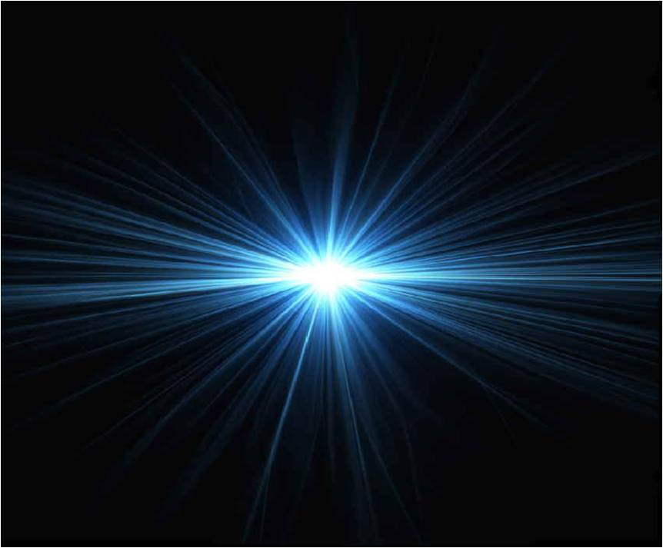
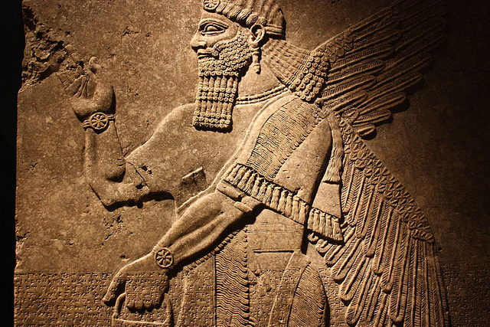
The Vision of Isaiah
God or Assyria?
An Example of Distrust
7-12

Slide 10
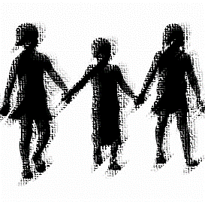
The Vision of Isaiah
Children,
Signs of God’s Presence
7:1 – 9:6
Notes:
God gives several signs or evidence in the form of children names that He can be trusted.

Slide 11
The Vision of Isaiah
Shear-jashub – 7:1-9
“a remnant shall return”
Immanuel – 7:10-25
“God with us”
Maher-shalal-hash-baz – 8:1-10
“quick to the spoil”
Notes:
All three of these children are children of Isaiah, [Actually there are only two children, Immanuel and Marher-shalal-hash-baz are one in the same, same child, by different name]. The use of these children names is which ties the segments together, Shear-jashub (7:3) Immanuel (7:14; 8:8) Maher-shalal-hash-baz (8:3) and the royal child in 9:5. “Over the machinations of the nations stands a group of children, helpless, and innocent. Yet in their innocence is a power which causes Isaiah to believe that right and justice are the great issues, not force and trickery. In light of this the thought moves from the folly distrust (7-8:22) to the reason to trust (8:23-9:6); strength is weakness; weakness is strength.
Shear-jashub – “a remnant shall return”; “a small number” – the name has a positive and negative sign to Kind Ahaz. It also meant “only a remnant”, not total annihilation.
Immanuel – “God with us” – can be used in a positive and negative way. The ten plagues of Egypt were used as a sign of God’s presence, a sign to the Egyptians of His judgement and a sign to Israel of her deliverance. Immanuel is positive in that it points to the delieverance from Syria and Israel, but it is also negative in that it shows that what overwhelms Judah’s enemies her well.
Maher-shalal-hash-baz – “quick to the spoil” – speaks of the swiftness of the judgment.

Slide 12
The Vision of Isaiah
Will You Believe?
“Shear-jashub”
“a remnant will return”
7:1 – 9
The Occasion
Notes:
The occasion is the Syro-Ephraimate threat.

Slide 13
Will You Believe?
“And it was told to the house of David, saying, ‘Syria's forces are deployed in Ephraim. So his heart and the heart of his people were moved as the trees of the woods are moved with the wind.” (7:2)

Slide 14
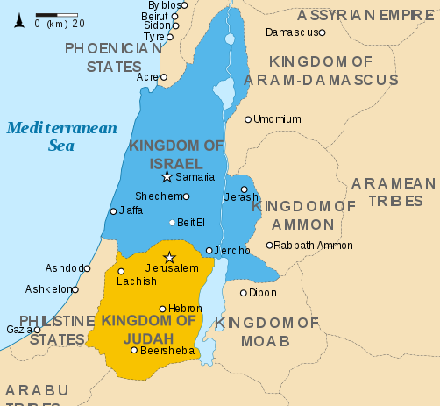
Will You Believe?
Notes:
“Because Syria, Ephraim, and the son of Remaliah have plotted evil against you, saying, ‘Let us go up against Judah and trouble it, and let us make a gap in its wall for ourselves, and set a king over them, the son of Tabel" Ahaz devise a plan to ask the king of Assyria to assist him, places his trust in him and not in the LORD.

Slide 15
Will You Believe?
“Then the LORD said to Isaiah, "Go out now to meet Ahaz, you and Shear-Jashub your son… and say to him: 'Take heed, and be quiet; do not fear" – “ (7:3-4)

Slide 16
Will You Believe?
“Why do the nations rage, and the people plot a vain thing? The kings of the earth set themselves, and the rulers take counsel together, against the LORD and against His Anointed… He who sits in the heavens shall laugh; The LORD shall hold them in derision.

Slide 17
Will You Believe?
“Then He shall speak to them in His wrath, and distress them in His deep displeasure: ‘Yet I have set My King on My holy hill of Zion.” (Psalm 2:1-6)

Slide 18
Will You Believe?
“It shall not stand… Syria… and Ephraim will be broken, so that it will not be a people.” If you will not believe, surely you shall not be established.” (7:7-9)
“established” “aman” - protected
Notes:
“The final statement in this verse sums up the whole issue. Unless Ahaz comes to the point where he can believe in God’s sovereignty to the extent of entrusting himself and his nation to God, he is doomed to live in the shaky, panicky condition he now experiences (v. 2). He need not enter into the terribly risky covenant with Assyria, if he will but take firm hold of the covenant which God offers, Assyria will not over the security Ahaz wishes. Only through trusting in the present and ultimate veracity of God is any real security possible.” Oswalt, p. 202.

Slide 19
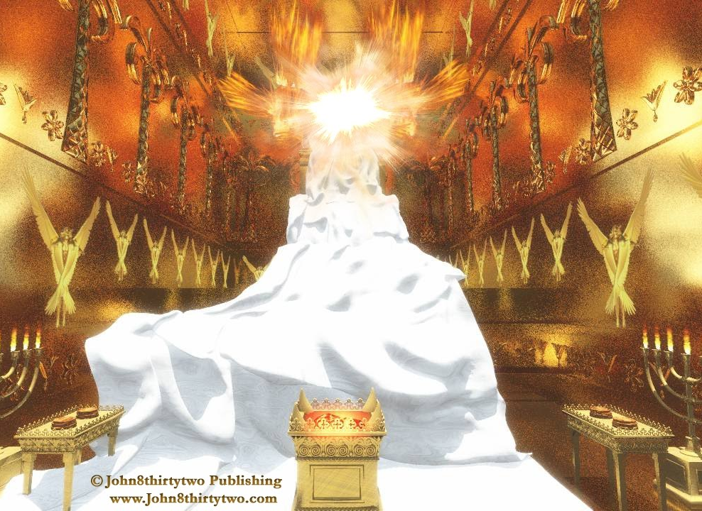
Will You Believe?
Ahaz has already established his faith in another, “the King of Assyria”, and has rejected and forsaken the LORD.
Notes:
The LORD give Ahaz and the physical line of David one last chance to trust in Him, by offering him evidence that the LORD can be trusted, but King Ahaz refuses.

Slide 20
Will You Believe?
“Hear now, O house of David! Is it a small thing for you to weary men, but will you weary my God also. Therefore the Lord Himself will give you a sign…” (7:13-14a)
The Watershed
Notes:
As a result the Lord is done with the physical house of David and will fulfill his promise to David to always have a descent of his on the throne ruling from Mt. Zion in a miraculous manner. This is the “WATERSHED” moment for the house of David. A “watershed” is “an event or period marking a turning point in a course of action or state of affairs.” The Lord through the prophet Isaiah begins to reveal now the manner and nature by which He will bring this about.
“…the children whom the LORD has given are for signs and wonders in Israel from the LORD of hosts, Who dwells in Mount Zion. (Isa 8:18) God is still with them believe it or not.
God is also with us, believe it or not. Jesus said, “I am with you always”. “If we are faithless, He remains faithful;” (2 Tim. 2:13)

Slide 21
Will You Believe?
God is with Us
7:10 – 8:10
“Believe It or Not”

Slide 22
God is with Us
The Sign of Immanuel
7:10 – 17
The Sign of Maher-shalal-hash-baz – 8:1-4

Slide 23
God is with Us
“…Behold, the virgin shall conceive and bear a Son, and shall call His name Immanuel.” (7:14b)
“…the prophetess, conceived and bore a son. Then the LORD said to me, ‘Call his name Maher-Shalal-Hash-Baz; ”(8:3)
Notes:
This passage has attracted immense interest. The greatest single focus of attraction has been the translation of “almah” or “parthenos” – virgin. Slightly less interest has been the attempt to identify the child “Immanuel”.

Slide 24
God is with Us
“a virgin” - `almah
Ahaz’s Wife – Hezekiah
Isaiah’s Second Wife
Isaiah’s First Wife – “prophetess”
Unidentified Young Women
Notes:
In Ahaz day, it only means that the young woman was “a virgin” at the time this prophecy was given not that she remained so at the child’s birth, as it was with Mary.

Slide 25
God is with Us
.
“a virgin” - `almah
“a young woman
of marriageable age”
Isaiah’s Wife – the prophetess
The Mother of the Three Named Children
Mary
Notes:
Isaiah's use of the Hebrew word “almah” allows him to refer to “the virgin” as simply a young women of marriageable age regardless of whether or not she had know a man or not. It could mean she was physically a virgin (had not sex with a man) or it could mean that she just simply a young woman whether she had had sex with a man was non-consequential. Both meanings are possible, conceivable, and applicable. “almah” applied to Isaiah’s wife and to Mary.

Slide 26
God is with Us
God is with Us
=
Immanuel
(7:10-17)
Maher-shalal-hash-baz (8:1-4)
=
Assyria
“like a razor”
(7:18-25)
Assyria
“like a flood”
(8:5-10)
Notes:
The Lord provides two additional signs in the form of one child with two different names, “Immanuel” which means and is translated “God with us” and “Maher-shalal-hash-baz,” which means “quick the spoil”.

Slide 27
Immanuel
Maher-shalal-hash-baz
The Lord Himself will give you a sign
So I approached
the virgin shall conceive and bear a Son
prophetess, conceived and bore a son
and shall call His name Immanuel
the LORD said ‘Call his name Maher-Shalal-Hash-Baz;’
before the child shall have knowledge to cry 'father and mother,'
before the Child shall know evil and good
the land will be forsaken by both her kings.
the spoil of Damascus and Samaria will be taken away
Notes:
The similarity of 8:1-4 to 7:10-17 is to close to be coincidental.
The relation of the sign to the birth and naming of a child is the same, even using the same language.
The significance of the child is the same. The child reaches a certain age and the military threat is removed. These events satisfies the demands for some specific fulfillment of the prophecy in Ahaz day.
The reoccurrence of “Immanuel” in 8:8 and in 8:10 argue that 7:10 – 8:10 constitutes a unit dealing with the Immanuel theme. The sign of Maher-shalal-hash-baz does not exhausts or complete the Immanuel idea. Assyria will not only destroy Damascus and Samaria, providing salvation, but will also sweep into Judah creating sense of doom, but still God is with them. The actuality of God’s presence waits for a much larger personage than the son of a prophet, but in the very son of God which Isaiah vision unfolds.

Slide 28
God is with Us
A Short and Long Term Fulfillment
Immanuel
3 -70 AD
729 BC
Notes:
The sign of Immanuel was two-fold: the birth of the child was to point to and to accompany the withdrawal of enemy forces. Many scholars have opted for a “double-fulfillment”. The first fulfillment was to occur during Ahaz’s time, and then applied later to Christ.
“So Ahaz’s sign must be rooted in its own time to have significance for that time, but it also just extend beyond that time and into a much more universal mode if its radical truth is to be any more than a virgin hope. (p. 211)
The disappearance of Syria/Ephraim was evidence that God was with them. But when Assyria appears was God still with them?
A child born in Ahaz’s time is not evidence that God is with us in all times. But if a child was born of a virgin conceived by God’s Spirit this would be a sign that God’s presence is with us all, for all time.

Slide 29
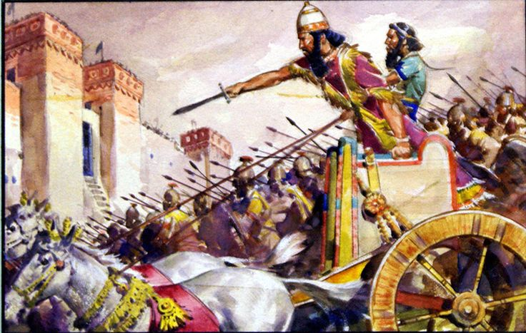
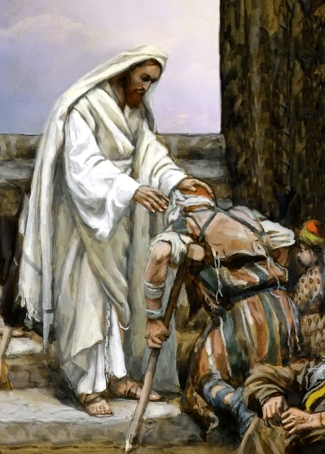
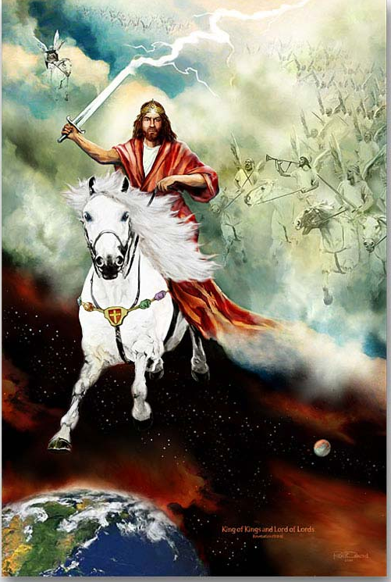
God is with Us
A Positive and Negative Fulfillment
Deliverance
and
Destruction
A Blessing
and
A Curse
Notes:
“The presence of a transcendent and holy God with us may well mean weal and woe together. To the extent that we are dependent upon Him, his presence results in blessing; but to the extent that we refuse to depend upon him, his presence is an embarrassment and a curse. Both realities are implicit in his presence” (Oswalt, p. 209)

Slide 30

God is with Us
The Sign of Maher-shalal-hash-baz – 8:1-4
Notes:
We have a very similar sign with double implications. A message of hope and confidence but also a message of doom. The material of chapter 8 goes beyond that of chapter 7, the coming doom is within God’s purposes, and he will not five the devouring nations permission to run amok indefinitely. The concluding section (11-22) establishes a reflection upon all which has preceded, begin in chapter 7 and it prepares the way for the announcement of the description of the child and the kingdom that He will bring in chapter 9.

Slide 31
God is with Us
“Moreover the LORD said to me, ‘Take a large scroll, and write on it with a man's pen concerning Maher-Shalal-Hash-Baz. And I will take for Myself faithful witnesses to record, Uriah the priest and Zechariah the son of Jeberechiah.” (8:1-2)
Notes:
Isaiah become part of the process of the signs that God was giving to the people.
He is instruction to take a large scroll… it is more like making a large banner or boaster with large letters to be proclaim the announcement of the birth of Maher-shalal-hash-baz – speeding to the plunder, hurry to the spoil, but also an annoucment to the coming attack.
It is believe that Uriah is the same high priest that King Ahaz had sent to Damascus to the design an altar fashioned after the one found there. King Ahaz then made offerings upon it to foreign gods. (2 Kings 16:10-16) So just as King Ahaz was forced to become party to the sign of Immanuel, Ahaz’s priest is made party to the sign of Maher-shalal-hash-baz. Men of public stature will be loudly know in advance concerning the Word of the Lord.

Slide 32
God is with Us
“Then I went to the prophetess, and she conceived and bore a son. Then the LORD said to me, "Call his name Maher-Shalal-Hash-Baz;” (8:3)
Notes:
Isaiah first make the banner or a billboard announcing the birth of the child signaling the coming deliverance and doom, and then conception of the child takes place. This called on an act of faith on the part of Isaiah similar to that which he was asking of his king and people.

Slide 33
God is with Us
“…for before the child shall have knowledge to cry 'My father' and 'My mother,' the riches of Damascus and the spoil of Samaria will be taken away before the king of Assyria.” (8:4)
Notes:
It is within three years when Immanuel / Maher-shalal-hash-baz became of age, to know the right from wrong, Assyria invades Syria and Ephraim and defeats them.
Judah’s enemies are destroyed, the line of David is preserved, and God can be trusted. Within a short time after the birth of the child these events will take place. And it is with the king of Assyria is with whom Ahaz has entered into the alliance with who fulfills the announcement. “So the king of Assyria listened to him; and the king of Assyria went up against Damascus and captured it, and carried the people of it away into exile to Kir, and put Rezin to death” (2 Kings 16:9) It is believed this occurred in the year 732 BC.

Slide 34
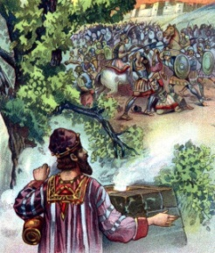
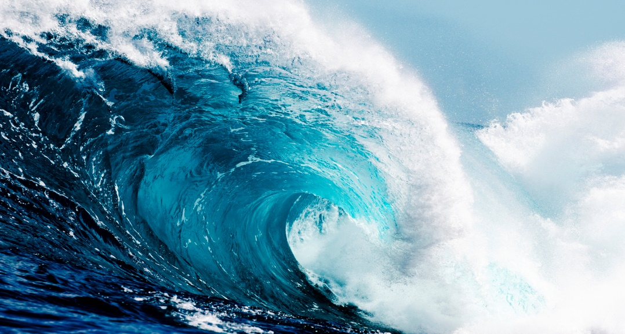
God is with Us
The Flood of Assyria, Yet God is with Us
8:5-10
Notes:
But, the king of Assyria does not stop in Ephraim, he continues on into Judah with devastating effect on the cities and the country, like a flood.
“So Tilgath-pilneser king of Assyria came against him and afflicted him instead of strengthening him. Although Ahaz took a portion out of the house of the LORD and out of the palace of the king and of the princes, and gave it to the king of Assyria, it did not help him” (2 Chronicles 28:20-21).
“The same sign which is a testimony to God’s faithfulness is also a word of destruction to those who will not believe. God’s presence does not mean automatic blessings to his people despite their unbelief… So Judah, delighting over the looting and plundering of her enemies, now learns to her horror that “quick to the spoil” applies to her as well.” (Oswalt, p. 224)

Slide 35
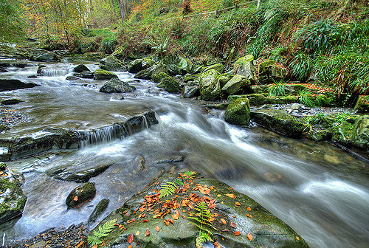
God is with Us
“The LORD also spoke to me again, saying: ‘Inasmuch as these people refused the waters of Shiloah that flow softly, and rejoice in Rezin and in Remaliah's son;” (8:5-6)
Notes:
They seemed to considered the help of their God as an ineffective as a little stream, compared to the mighty nations of the world seems like the Euphrates.
It may well be that the Judeans were congratulating themselves over Ahaz’s diplomatic coup in allying himself with the king of Assyria. It is not God who has delivered them, but their own wisdom. To all of this Isaiah says the celebration is too early.

Slide 36
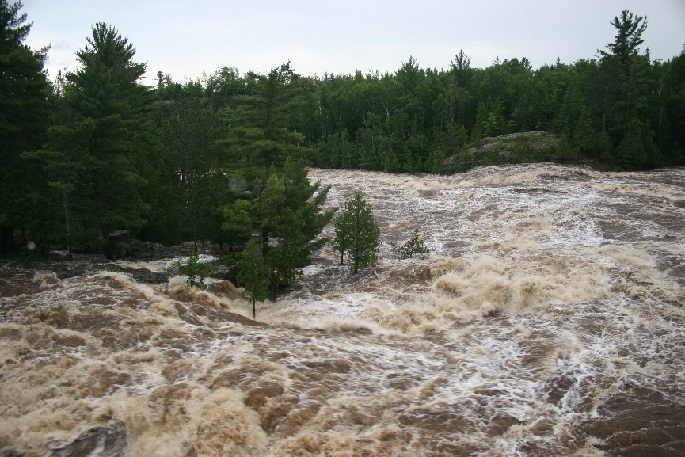
God is with Us
“Now therefore, behold, the Lord brings up over them the waters of the River, strong and mighty -- The king of Assyria and all his glory; He will go up over all his channels and go over all his banks….”(8:7)
Notes:
Therefore, behold…” is the message formula introducing the announcement section of judgment speech. God is about to act. It is the Lord, Adonai, the Sovereign One who brings judgment.
“the River” – Euphrates by which the Assyria crossed, a mighty river compared to anything the Israelites had seen.

Slide 37
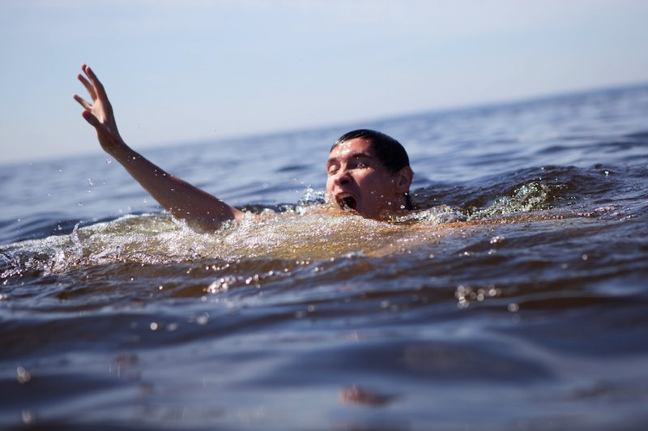
God is with Us
“He will pass through Judah, He will overflow and pass over, He will reach up to the neck; And the stretching out of his wings will fill the breadth of Your land, O Immanuel.”(8:8)
Notes:
Floods can be very destructive, but this flood will not destroy Judah completely. It will stop short of total destruction, annihilation or extermination.
Isaiah them changes metaphors and relates their experience from a flood to a bird, a bird of prey. He is stressing the spreading out of an army, boots on the ground. The land which the bird spreads it wings is Immanuel’s land. The flood only reaches to the neck, but now further, and the bird has the prey in its grasps but will not carry off the lamb. Why? Because Judah is so wise and powerful? No! What can stop the flood? A mighty fortress? No! Immanuel will put an end to it, who is pictured here as a helpless little child. It is the trickling waters of Shiloah which that the Judeans rejected as being of no use.
Immanuel is the owner of the land which is threatened and the Assyria have taken up lodging. This cannot simply be Isaiah son. It could only be the Messiah, he is the mighty fortress who is our God. Isaiah plunges deeper and deeper into the implications of the sign “God is with us”, and, best of all “will be with us”, not merely in the events of history or in the events of our life, but somehow as a person.

Slide 38
God is with Us
“Be shattered, O you peoples, and be broken in pieces! Give ear, all you from far countries. Gird yourselves, but be broken in pieces; Gird yourselves, but be broken in pieces. Take counsel together, but it will come to nothing; Speak the word, but it will not stand, for God is with us.”(8:9-10)
Notes:
We have a series of commands to the nations to prepare for war against God’s people and their God. But their plans will fail, it will not stand, for God is with us. It does not mean that the sins of God’s people will not go unpunished or God will not at times use a heavy hand of disciple against God’s his servants. But it does mean that judgment and destruction is not the final word. It is judgment unto salvation when God is with us.
“it shall not stand” – the segment 7:1 – 8:10 ends with where it began. The nations counsel against the LORD’s anointed but He only laughs (Psalm 2).
Man strives to enter God’s world and fails, but it is God who is the One who enters our world, through a little helpless child, it is a Lamb that will defeat them.

Slide 39
God is with Us
“These will make war with the Lamb, and the Lamb will overcome them, for He is Lord of lords and King of kings; and those who are with Him are called, chosen, and faithful.” (Revelation 17:14)

Slide 40
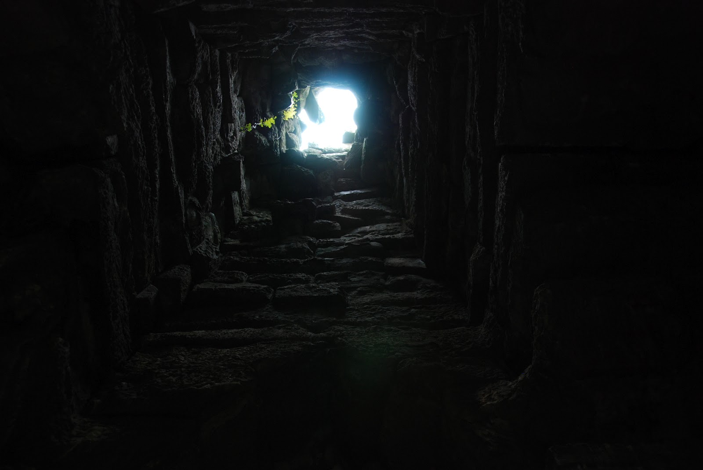
God is with Us
Our Way – Darkness;
His Way – Light
8:11-23
Notes:
This section establishes a reflection upon all which has preceded, begin in chapter 7. It prepares the way for the announcement of the description of the child and the kingdom that He will bring in chapter 9. This is no ordinary child.
“It makes plain the central theme of the segment: “In what, or in whom, shall we trust?” One possibility when faced with potential calamities or disasters, is to forget God’s sovereignty and proceed accordingly, but to do so is to invite the calamity of more profound nature, for God is the one fact we dare not overlook. It is sheer foolishness (our way) , when he has made his way clear to resort to some other means to find a path out of darkness. These other means that man devises can only make the darkness, and our anguish, more intense, for they lead away from him who is the Light. Nevertheless, God will not be defeated. He will shed his light upon his people, it is typical of his grace that the location of that light will be in the part of the land which first felt the hand of his wrath, namely Galilee.” (Oswalt, p. 231-232)
Man, when faced with political, social, and military upheavals focus upon various human conspiracies as the source of his troubles of which he gives primary attention. While they forget God as the source, people resort to magical and mystical means of divination and to learn the future and find guidance.
Isaiah’s response is that given God’s terrifying holiness, his written revelation, and his desires to give his people light, dependence upon anything other than him is sheer insanity.
Many, if not most commentators miss the thematic and theological unity of this section, because of the abrupt and indirect transition. This may be because that the material was not all composed at the same time. The speech is the result of a intense spiritual experience of the prophet.

Slide 41
God is with Us
“They will pass through it hard-pressed and hungry; and it shall happen, when they are hungry, that they will be enraged and curse their king and their God, and look upward. Then they will look to the earth, and see trouble and darkness, gloom of anguish; and they will be driven into darkness.” (8:21-22)

Slide 42
God is with Us
“Nevertheless the gloom will not be upon her who is distressed, as when at first He lightly esteemed the land of Zebulun and the land of Naphtali, and afterward more heavily oppressed her, by the way of the sea, beyond the Jordan, in Galilee of the Gentiles.” (9:1)

Slide 43
God is with Us
“The people who walked in darkness have seen a great light; Those who dwelt in the land of the shadow of death, upon them a light has shined.” (9:2)

Slide 44
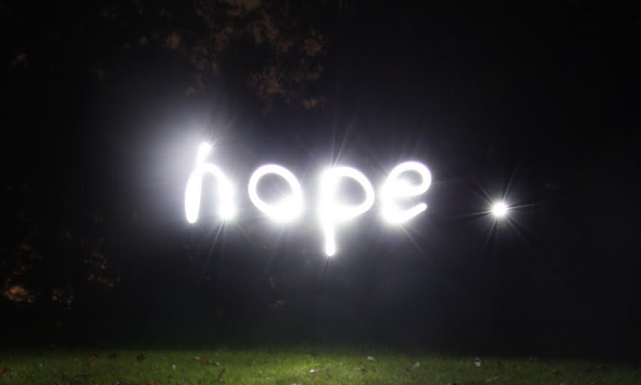
God is with Us
Notes:
Hope shines out of darkness.

Slide 45
The Vision of Isaiah
Notes:
Trust the Lord and believe His signs/evidence that His Word is true, and you will be established on the earth. Distrust the LORD and refuse the evidence and perish from the earth.

